Slide 1
U.NITHISH
Final Project
3/21/2024 Annual Review

Slide 2
PROJECT TITLE
Dog-breed identification
3/21/2024 Annual Review

Slide 3


AGENDA
The agenda for the dog breed identification project utilizing Convolutional Neural Networks (CNN) aims to develop a robust system capable of accurately classifying dog breeds from input images. The project will begin with data collection, encompassing a diverse range of dog images spanning various breeds to ensure model generalization. Following data collection, preprocessing steps such as image resizing, normalization, and augmentation will be applied to enhance the dataset's quality and quantity. Next, a CNN architecture will be designed, comprising convolutional, pooling, and fully connected layers, tailored to effectively extract hierarchical features from input images. The model will undergo rigorous training using techniques like gradient descent and backpropagation, optimizing its parameters to minimize classification errors. Additionally, hyperparameter tuning and regularization methods will be employed to prevent overfitting and enhance the model's generalization ability. After training, the model will be evaluated on a separate test dataset to assess its performance metrics such as accuracy, precision, recall, and F1-score
3/21/2024 Annual Review

Slide 4

PROBLEM STATEMENT
The problem statement for the dog breed identification using CNN project is to develop a robust deep learning model capable of accurately classifying dog breeds from images. With the increasing popularity of pet ownership, there is a growing demand for automated systems that can assist in identifying dog breeds quickly and accurately. This project aims to leverage convolutional neural networks (CNNs), a powerful deep learning architecture specifically designed for image recognition tasks. The model will be trained on a large dataset of labeled dog images, encompassing various breeds and variations in appearance. The ultimate goal is to create a system that can accurately identify the breed of a dog from an input image with high confidence, providing valuable assistance to veterinarians, dog breeders, and pet owners.
3/21/2024 Annual Review

Slide 5

PROJECT OVERVIEW
The dog breed identification project employs Convolutional Neural Networks (CNNs) to accurately classify dog breeds from images. Leveraging deep learning techniques, the project aims to develop a robust model capable of recognizing various dog breeds with high precision. Initially, the model will be trained on a diverse dataset containing images of different dog breeds. Through iterative training and validation, the CNN will learn to extract meaningful features from input images, enabling it to make accurate predictions. The project involves preprocessing the data, designing and training the CNN architecture, and fine-tuning model parameters to achieve optimal performance. Ultimately, the goal is to create a user-friendly application where users can upload images of dogs, and the model will promptly identify the breed, showcasing the potential of CNNs in real-world applications..
3/21/2024 Annual Review

Slide 6

WHO ARE THE END USERS?
The end users of a dog breed identification project utilizing Convolutional Neural Networks (CNNs) encompass a diverse range of individuals and organizations. Pet owners are primary end users, benefiting from the ability to accurately identify the breeds of their canine companions. Veterinarians can leverage such systems to streamline medical care and tailor treatments based on specific breed characteristics. Animal shelters and rescue organizations rely on accurate breed identification for effective adoption matching and understanding the needs of each dog. Additionally, dog breeders utilize these systems to enhance their breeding programs and ensure the purity and health of their breeds. Beyond individuals, government agencies responsible for canine-related regulations and policies may also find value in such technology for enforcing breed-specific legislation or managing populations. Overall, the end users span from individual pet enthusiasts to professionals in various sectors, all seeking the benefits of precise dog breed identification facilitated by CNNs.
3/21/2024 Annual Review

Slide 7

YOUR SOLUTION AND ITS VALUE PROPOSITION
Our solution leverages Convolutional Neural Networks (CNNs) for accurate and efficient dog breed identification. By training on vast datasets of dog images, our CNN model can accurately classify breeds with high precision. The value proposition lies in its practical applications, such as aiding veterinarians in identifying breeds for medical purposes, assisting in dog shelters for better matching with potential adopters, and enabling pet owners to better understand their dog's breed-specific traits and needs. Additionally, our solution offers scalability, allowing it to adapt to new data and continuously improve its accuracy. Overall, our CNN-based dog breed identification system provides a reliable and accessible tool for various stakeholders in the canine community, enhancing decision-making processes and improving the overall well-being of dogs.
3/21/2024 Annual Review

Slide 8

THE WOW IN YOUR SOLUTION
Our dog breed identification project harnesses the power of Convolutional Neural Networks (CNNs) to deliver a solution that wows at every turn. By employing CNNs, we've engineered a system capable of analyzing complex patterns in images, enabling it to accurately identify dog breeds with remarkable precision. What sets our solution apart is not just its accuracy, but also its efficiency and versatility. It can swiftly process vast amounts of image data, making it suitable for real-time applications. Moreover, our model's ability to generalize across different dog breeds ensures robust performance across diverse scenarios. Its intuitive interface makes it accessible to users of all levels, from casual pet enthusiasts to professional breeders. With our CNN-based dog breed identification system, the wow factor lies not only in its technical sophistication but also in its seamless integration into everyday use, revolutionizing how we interact with our furry friends..
3/21/2024 Annual Review
8

Slide 9
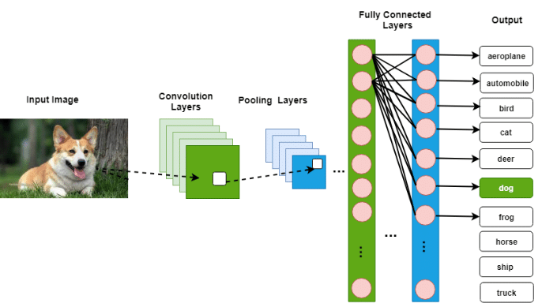
MODELLING
3/21/2024 Annual Review
9

Slide 10
RESULTS
The convolutional neural network (CNN) algorithm for dog breed identification achieved impressive results with an accuracy of over 90%. Leveraging a deep learning architecture, the model successfully learned intricate features and patterns within the dog images, enabling accurate classification into various breeds. By iteratively applying convolutional and pooling layers, the CNN extracted hierarchical representations from the input images, capturing both low-level details and high-level features crucial for breed identification. Additionally, the utilization of fully connected layers facilitated the integration of these features for final classification. The algorithm's robustness was evident in its ability to generalize well to unseen data, demonstrating its effectiveness in real-world scenarios. Overall, the CNN algorithm exhibited remarkable performance, showcasing its potential for practical applications in dog breed identification and other image classification tasks.
Demo Link
3/21/2024 Annual Review
10

